Slide 1

Coconino County Road Maintenance Sales Tax Initiative Proposition 403 Presented By Coconino County Supervisor Matt Ryan October 19, 2017
Notes:
I am Coconino County Supervisor Matt Ryan and I will be presenting you information about our experience with a successful Ballot Initiative for a sales tax dedicated to roads

Slide 2
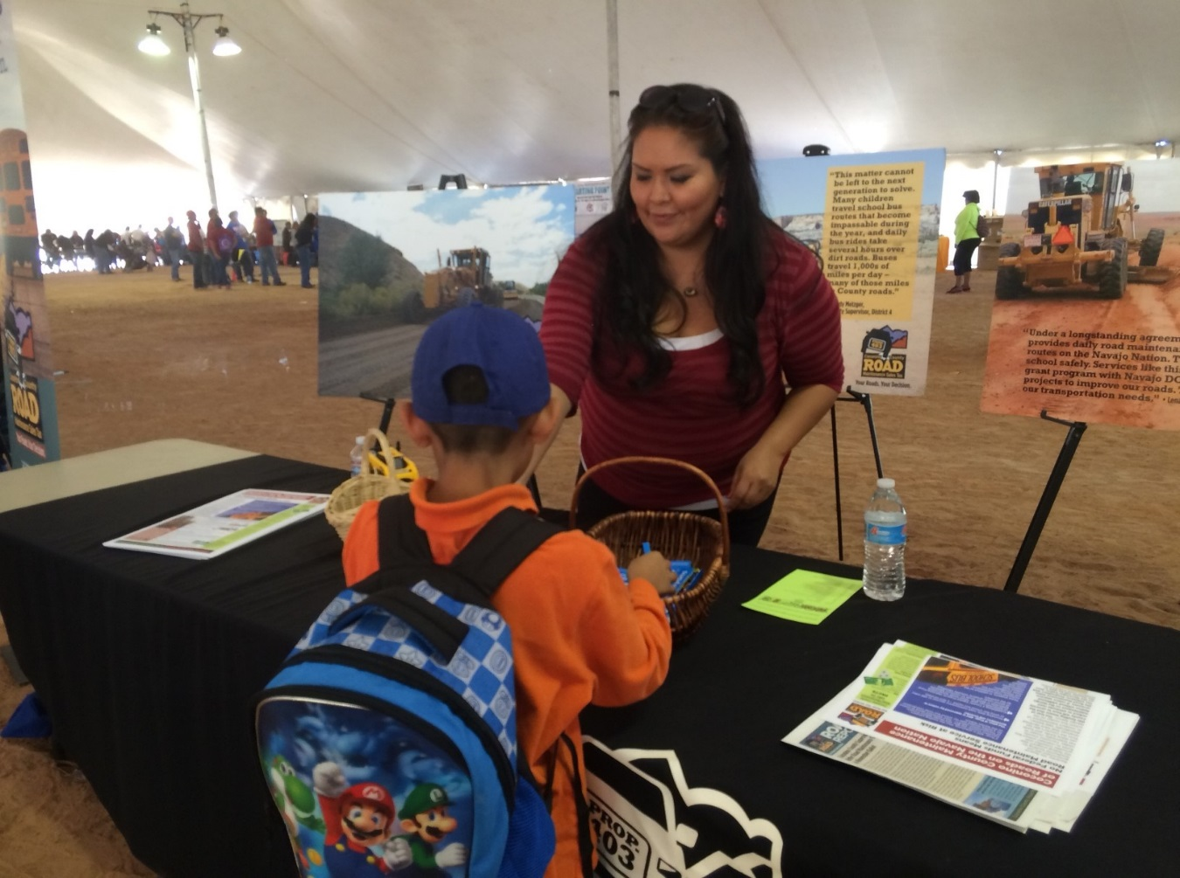

Introductory Remarks
What triggered the push for the County Ballot Initiative?
A Decision is Made
Gaining Support for the Initiative
Challenges in the Process
Ballot Initiative Passes
Accomplishments
What will the Future Hold?
Lessons Learned (Advice to Others)
Notes:
I will explain what triggered the push for our County to go for a ballot initiative, how our Board came to that decision, gaining support for the initiative, challenges in the process, the passing of the initiative, accomplishments since implementation, what the future holds and lessons learned.

Slide 3
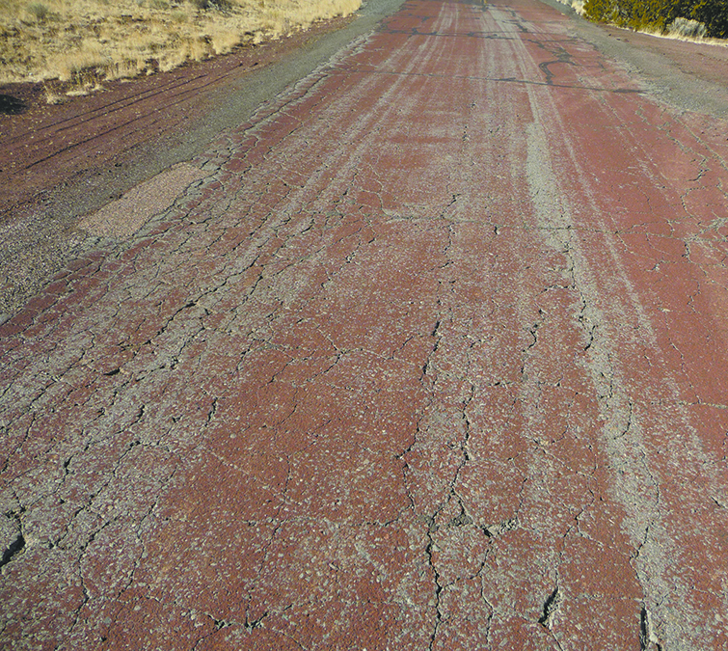
The Push Toward the Initiative
Over seven years, County trimmed road maintenance costs by reducing permanent, annual costs by $2 million:
Eliminated positions
Extended equipment
life cycles
Balanced equipment use
Reduced fleet size
Implemented more efficient
snow plan
Notes:
What we are responsible for:
Coconino County maintains approx. 1,000 miles of roads
About 2/3 are dirt and 1/3 paved
About 2/3 are County-owned and 1/3 owned by USFS and 1/3 owned by BIA and maintained by the County through long-standing agreements
(READ SLIDE)

Slide 4
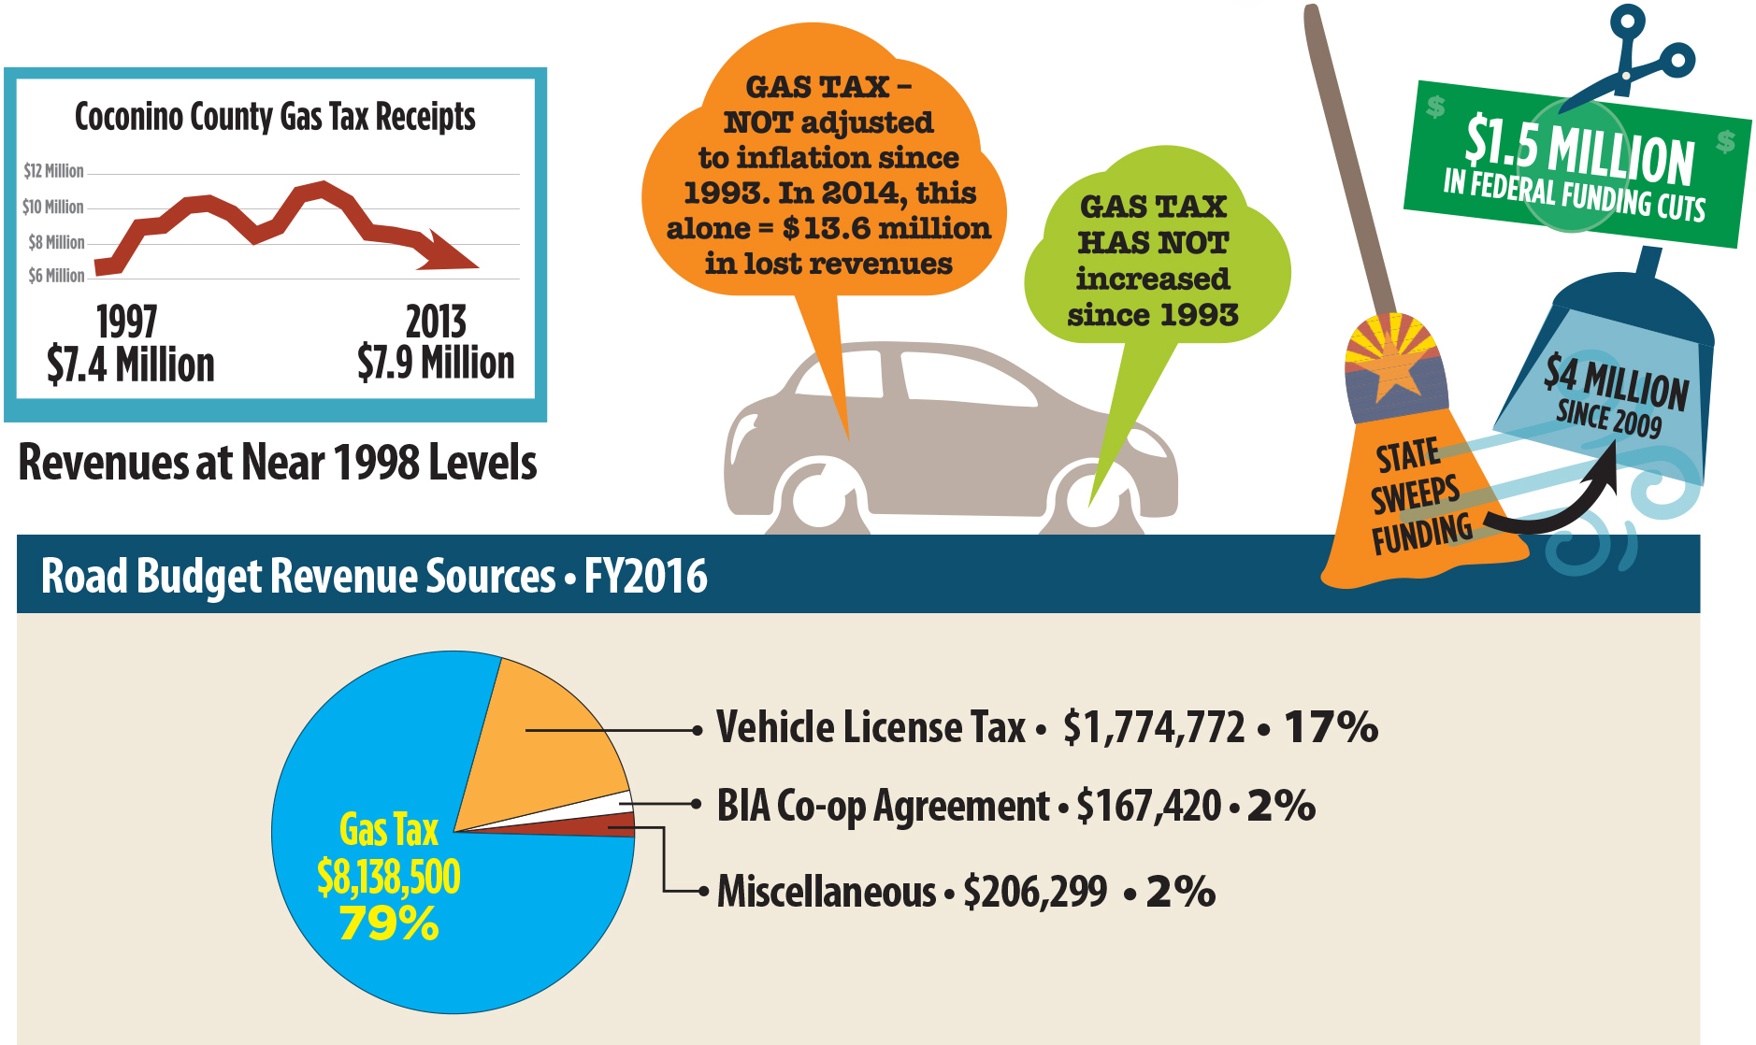
The Push toward the Initiative: The Gas Tax Challenge
Notes:
We know we got to the point of going for an initiative because of a combination of factors. One was the significant decline in revenue. And the other was the poor condition of our paved roads.
Bottom line – we could not operate at the same level of service on 1998 revenue levels.
(Read the stats/info on the slide)

Slide 5
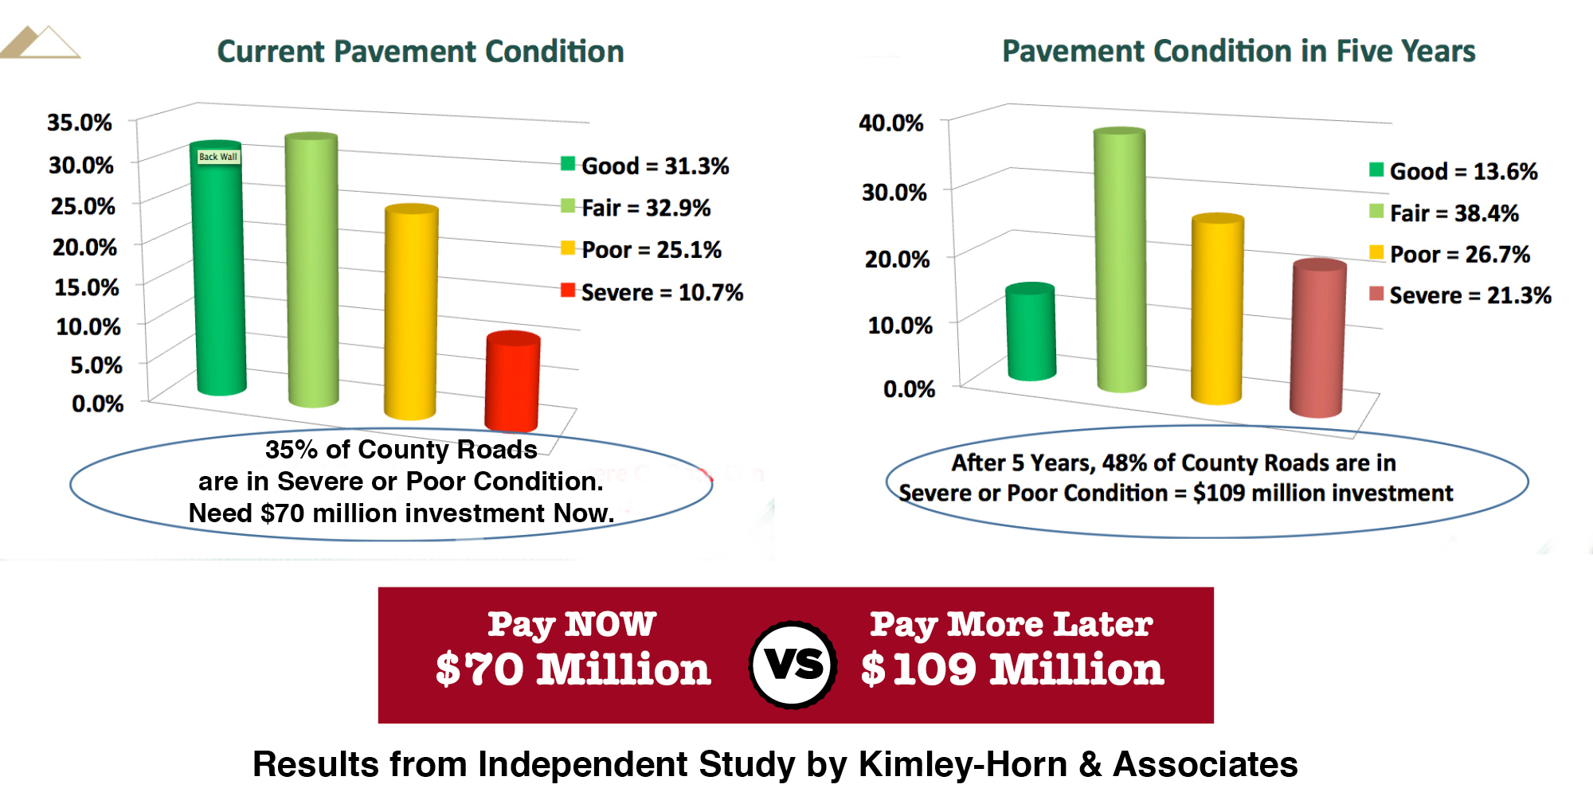
The Push Toward the Initiative: Pavement Conditions
Notes:
We had an Independent pavement evaluation conducted.
It determined that 35% of County paved roads were in severe or poor condition and needed about $70 million in investment.
It also found that if we waited five years with no investment, then 48% of the paved roads would be in severe or poor condition and cost at least $109 million to address.
These facts were key to understanding the long-term impact if no investments were made in our paved road assets

Slide 6
The Decision Is Made to Go for the Ballot Initiative
Our Board decided to place 3/10 of a cent sales tax for 20 years on the November 2014 ballot (Sunsets Dec 31, 2034)
If tax was approved by the voters, it would:
Allow County to support the current road maintenance service level and avoid 40% reduction in service level (like going to only one shift of snow removal)
Allow County to make much needed investments in paved road assets
Allow County to continue maintaining roads on the Navajo Nation
Notes:
What Did it take for the Board to get to this point? Our Board spent over two years evaluating the issue and options for addressing what would be over a $100 million deficit in 10 years if costs, and therefore services, were not reduced significantly.
There were over 16 Board work sessions on the issue
we conducted two voter surveys & focus groups
we secured an independent evaluation of the 320 miles of County-maintained paved roads
We convened a Citizen Advisory Committee, which met 8 times and ultimately made a recommendation that the Board place a sales tax on the ballot for UP TO ½ cent for NO LESS THAN 10 years
As said before, we had already reduced road maintenance costs by $2 million
(Read Slide as well)

Slide 7
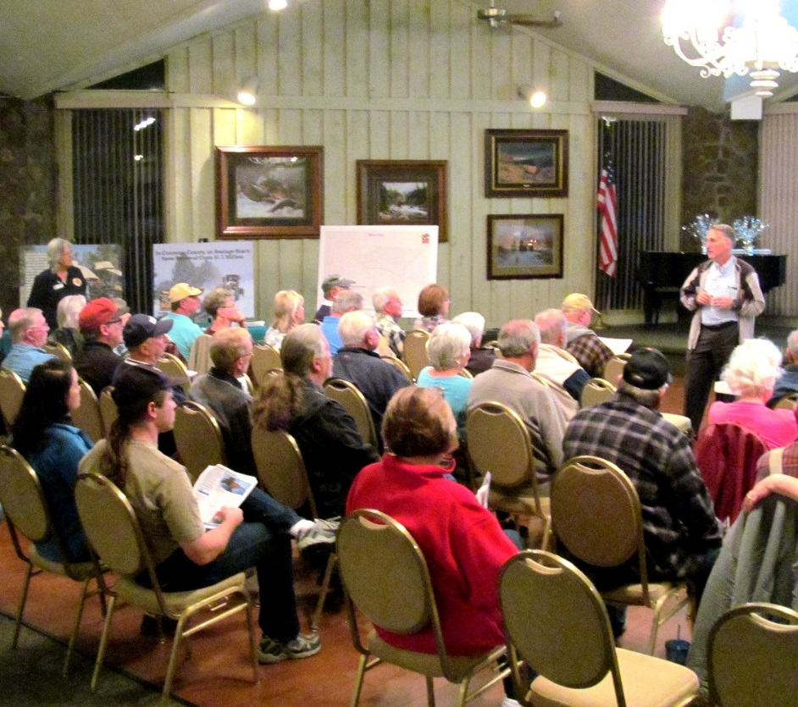
Gaining Support: Major Voter Education Effort
Over 125 Presentations – Board Member(s) Present
Over 4 dozen open houses/community meetings
Almost a dozen Navajo Nation Chapter meetings & several other major meetings on the Navajo Nation, as well as community events
Social media, publications, visuals for offices & events, BOS emails to constituents, utility bill stuffers, employee communications
Notes:
THE NEXT STEP WAS GAINING SUPPORT FOR THE INITIATIVE.
Our County made a major investment in educating our voters about Prop 403. Why?
We know from prior elections that voters in Flagstaff and in the County expect a high level of voter education.
We had a responsibility to educate voters about the tax initiative so they could make an informed decision, especially since in this case road maintenance services would have been cut significantly if the initiative was not approved and it would impact everyone’s lives everyday.
(Read Slide)

Slide 8
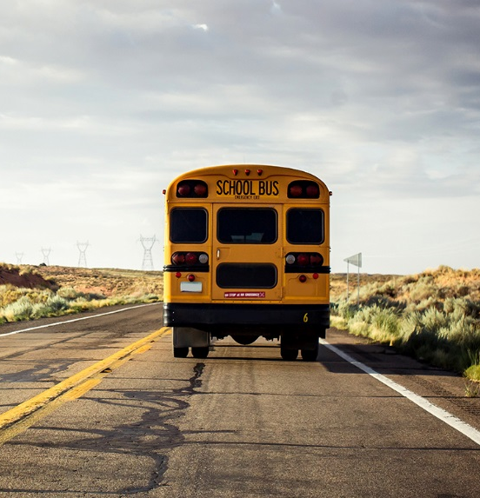
Gaining Support: Key Messages
No new revenue = 40% reduction in road mtn services
County roads = key element of overall transportation system supporting our daily lives and economy
Roads are key to school districts
Roads are essential to emergency services
Access to outdoor recreation via Forest Service roads maintained by the County is key attraction for residents, employees & tourists
Economic benefits
Level of road maintenance service is decision by voters
Notes:
During our Voter Education Effort, we had key messages to deliver to the voters and they included:
(read slide)
Note that FUSD buses travel 8,000-10,000 miles per day

Slide 9
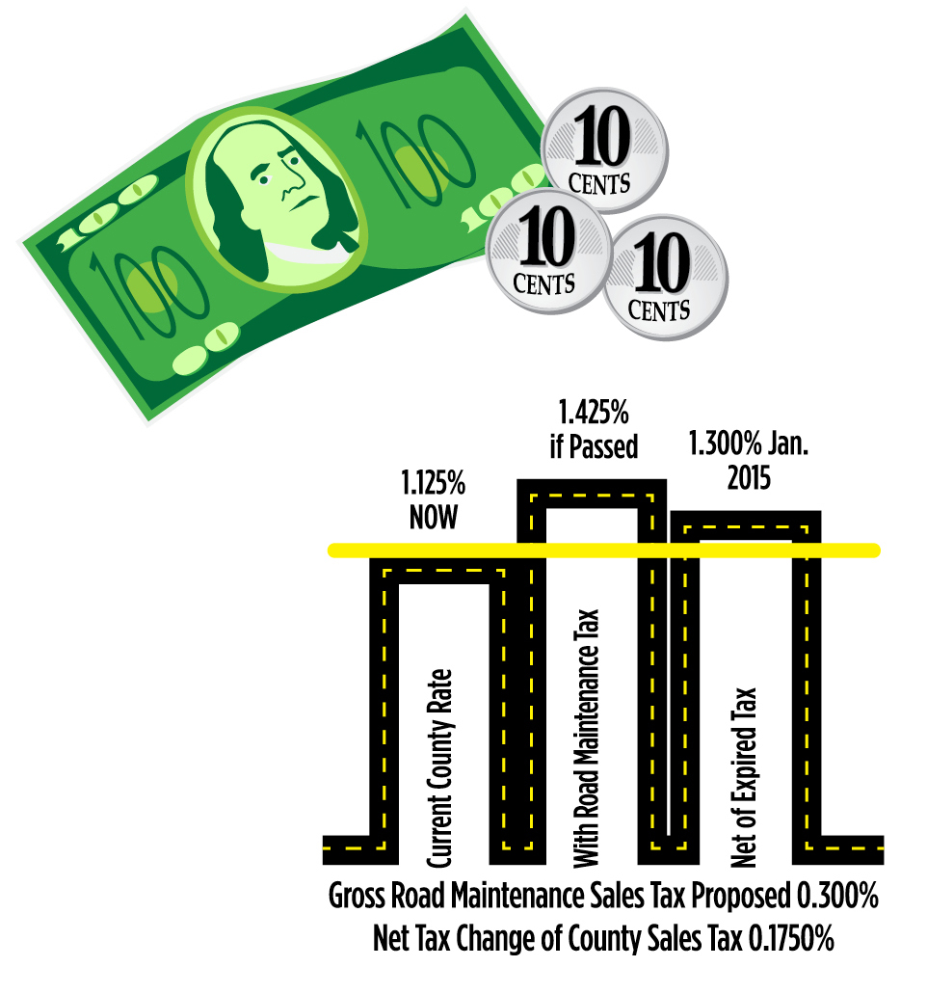
Gaining Support: Key Messages
RATE – Three-tenths of one percent ($0.003), or 30¢ on a $100 purchase
NET TAX INCREASE -- Another County tax expires this fall, so the net tax increase will be 17½¢ on a $100 purchase
RESTRICTIONS – funds can ONLY be used for road-related costs per statute & ballot language; funds CANNOT be swept by the State
Notes:
Additional key messages include:
(read slide)
Again, this is for 20 years from Jan 1, 2015 to Dec 31, 2034.

Slide 10
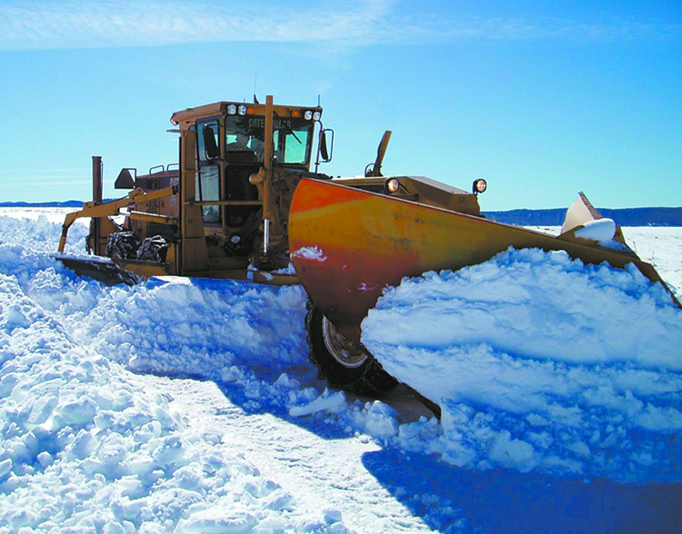
Gaining Support: Communicating Impact of No New Revenue
Routine road maintenance reduced by
up to 40%
Snowplows operate one shift, 7a.m.–4 p.m.
Defer all capital projects, except grant-funded
Equipment replaced only when it fails, if funds are available
Elimination of County maintenance of school bus routes on the Navajo Nation
Notes:
Part of our Voter education effort included communicating what it would mean if we did not get new revenue.
This included:
(read slide)
Then say points below
The reduction in snow plow service would have likely had the most impact on road users and employers
Successive bad snow years, disasters or road failures could make service levels even worse than this going into the future.
We were basically communicating our plan on how we would go about reducing service level, develop potential exit strategies and work with staff to reduce service levels to match revenues.
This would have included eliminating maintenance service on reservation and forest service roads, which many residents live on or off of.

Slide 11
Gaining Support: Communicating How Funds Will Be Used
Service County-maintained roads, including County-owned, USFS and BIA roads at current service level, including snow plowing
Implement the County’s Road Capital Improvement Plan, which includes primarily pavement maintenance and safety improvement projects
Replace equipment on schedule to reduce service maintenance costs & to secure routine road maintenance service level
Notes:
In our Voter education effort we also communicated how new revenue would be used if the initiative passed.
A lot of it was just to keep maintenance service levels just at current levels of what the community was use to instead of seeing a drastic cut to service.
(read slide)

Slide 12
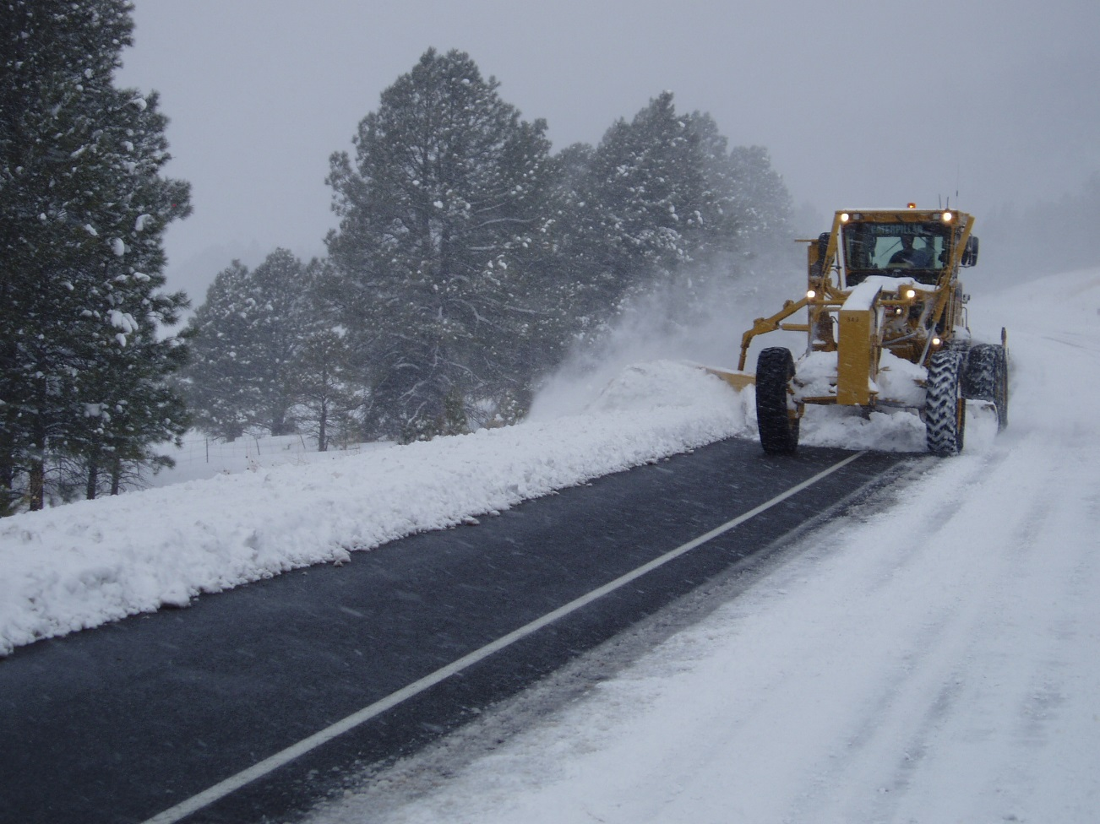
Gaining Support: Communicating How Funds Will Be Used- Revised Snow Plan
We had experience with a Revised Snow Plan in 2013
Learned from a few areas where we experienced challenges & modified the plan accordingly; funds would allows us to modify as needed
Would allow Public Works to hire temporary snow operators as we had done historically
Overall PW Workforce Plan would identify resources needed to meet service levels & retain $2 Million in permanent savings
Notes:
(Read Slide)
Essentially we could bring our snow plow maintenance levels back up to make it safer for travelers on our roads

Slide 13
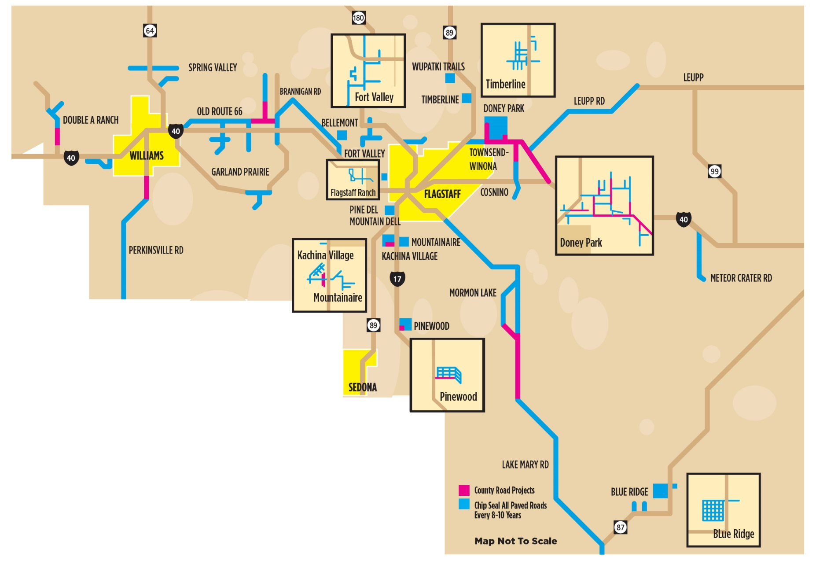
Gaining Support: Communicating How Funds Will Be Used
Notes:
We would be able to make an investment into our road assets by moving forward with a capital improvement plan.
We had a capital project plan laid out for the community to see and communicated how we came up with the plan.
We communicated the Criteria for the selection of the CIP projects such as Average Daily Traffic, pavement condition, safety and cost
We communicated that the plan was a plan and not necessarily cast in concrete. As info was gathered, priorities could be modified by staff and Board.
We communicated what the caveats relative to the plan were: seasonal snow severity, unanticipated road/bridge failures, new mandated programs, response to natural disasters, economic downturns, commodity cost fluctuations and further reductions in Highway User Revenue Funds (HURF)
We communicated the Bottom line- that we would get our direction from the voters irrespective of that direction, we as an organization would respond in an organized and methodical approach, as we had done over the past several years.

Slide 14
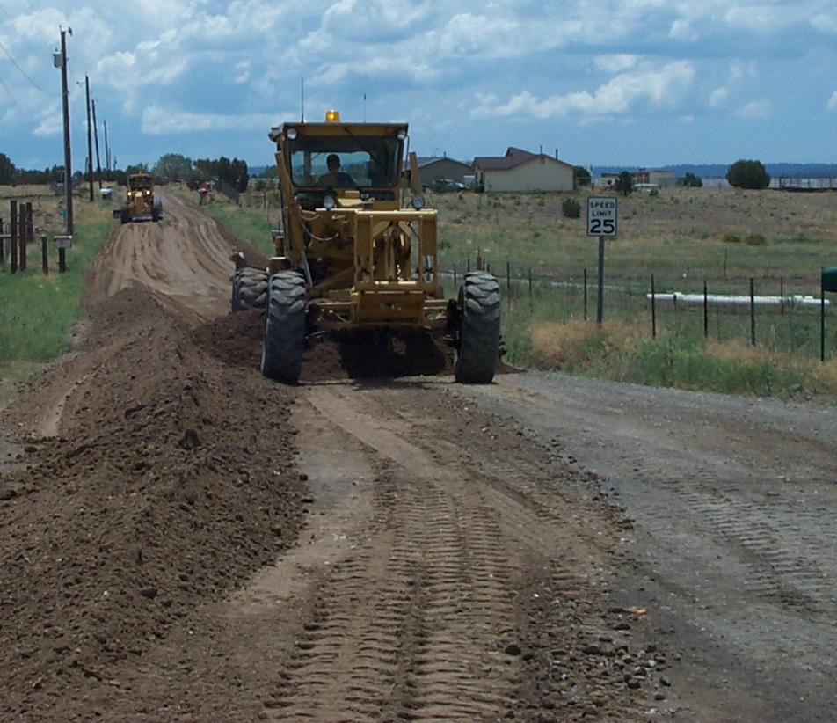
Challenges in the Process
No one wants to increase taxes!
Coordinating with City of Flagstaff- they also ran an initiative
Political Action Committee
Educating our own organization
Funding the Educational Effort- taking that risk
Notes:
(Read Below)
No one wants to increase taxes- must define why it is needed to a distracted audience
Coordinating with City of Flagstaff- they also ran a road tax initiative on the ballot at the same time. They proposed a 1/3 of 1 percent sales tax to repair city streets, which was about 33 cents on a $100 purchase. If voters were to approve both the County’s and the City’s then the total tax rate within the City would be 8.951 percent, which was in line with most other cities tax rates. Their tax also passed on the ballot at the same time. ½ of population lives in City of Flagstaff, 2/3 live in Flagstaff metro area.
Political Action Committee- people buying into it- support neutral positions (we didn’t have support from Flagstaff Chamber as they remained neutral)
Needing to educate our own organization – all hands on deck and at least one supervisor needed to attend every meeting to as k for the vote as staff could not do so
Funding the educational effort- taking the risk without certainty it would pass

Slide 15
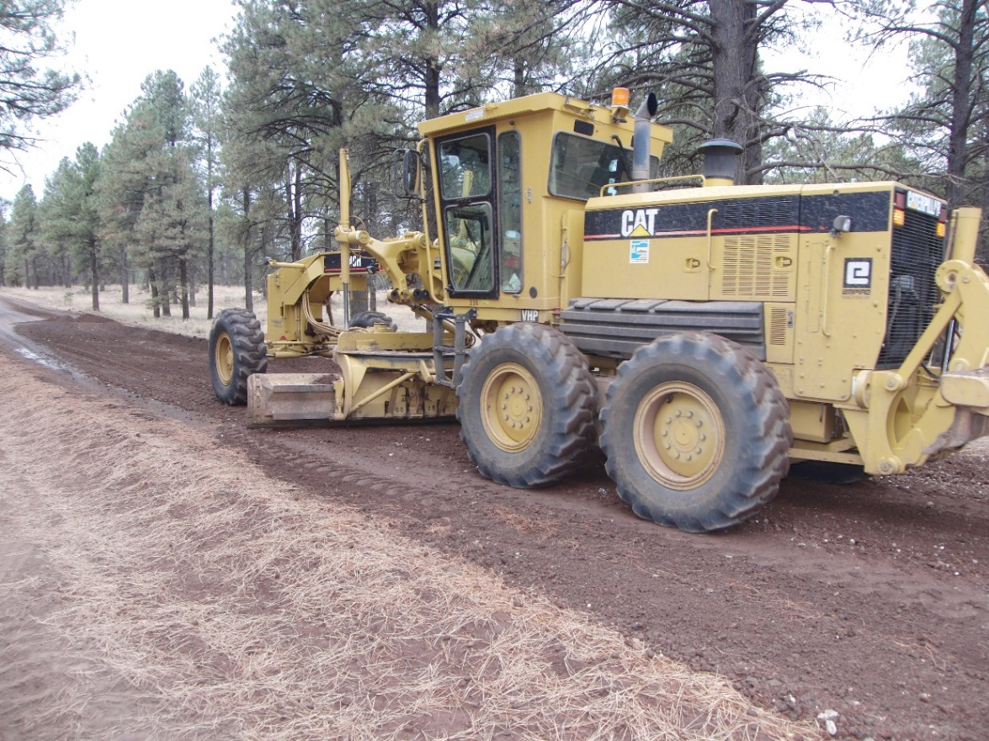
Ballot Results: Initiative Passes with Strong Voter Support
Election results showed strong voter support with about 65% of voters throughout the County in support of the measure.
69% of Flagstaff voters supported the measure.
Strong support from all areas where we provide road maintenance services.
Notes:
(Read Slide)

Slide 16




Accomplishments
“Promises Made”
“Promises Kept”
Notes:
You can see in this slide our logo change with the pass of the initiative.
The sales tax provides $6 to $7 million per year in revenue with roughly ½ going to routine road maintenance and about ½ going to capital investments in paved roads.

Slide 17
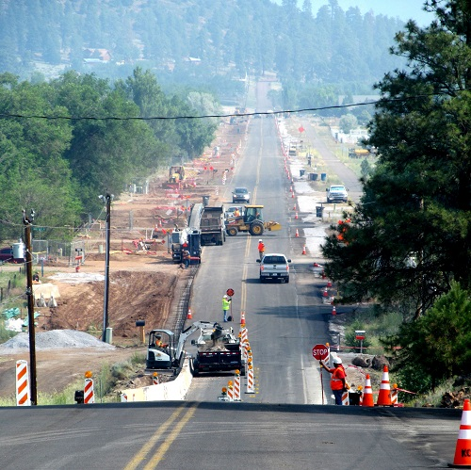
Accomplishments: Implementation Began in 2015
Notes:
With clear mandate from voters, the County has moved forward with implementation.
A workforce plan was developed to support routine road maintenance and Capital Improvement Plan investments
Continuing efficiency efforts to retain $2 million in long-term savings
Negotiated agreements with the BIA on routine road maintenance and matching capital plan

Slide 18
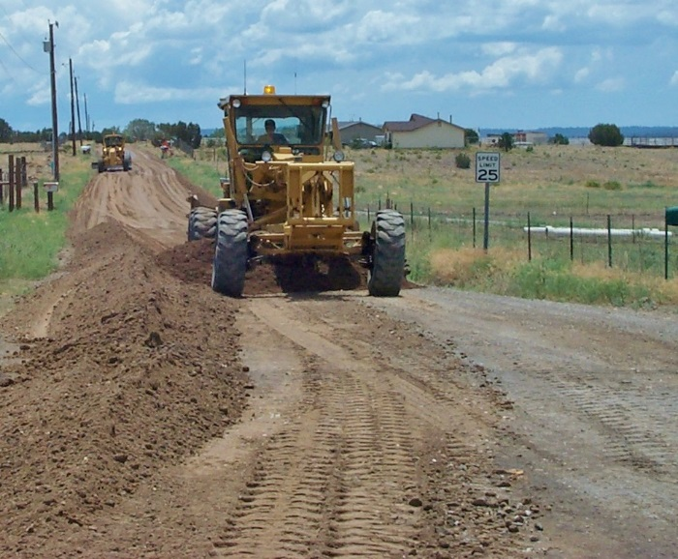
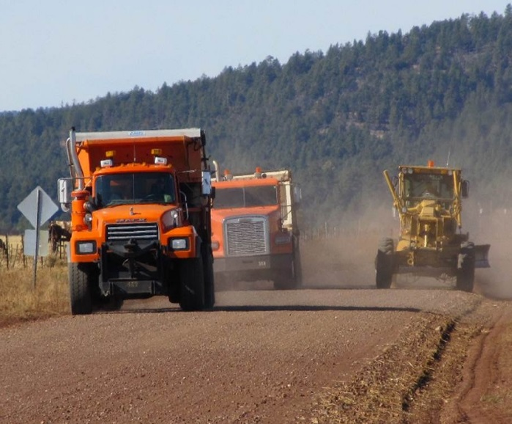
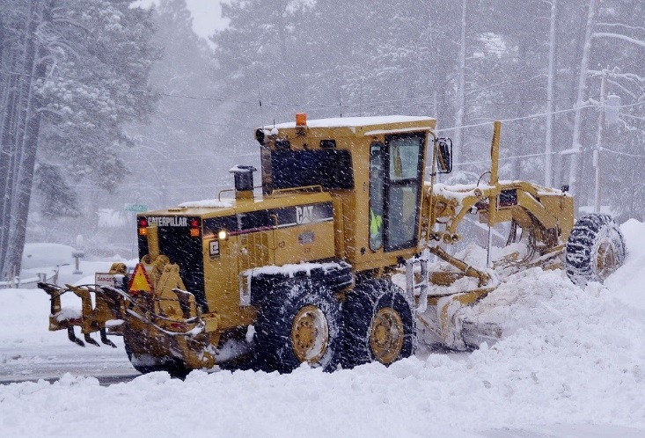
Accomplishments: Routine Road Maintenance
Actions Taken to Address Service Level:
Addressed service level issue – filled Senior Operator and Operator Positions; Conducted significant training
Established two Operator Trainee Positions so have our own “bench”
Successfully hired 18 Temporary Snow Plow Operators for Snow Season
Notes:
(Read Slide)

Slide 19
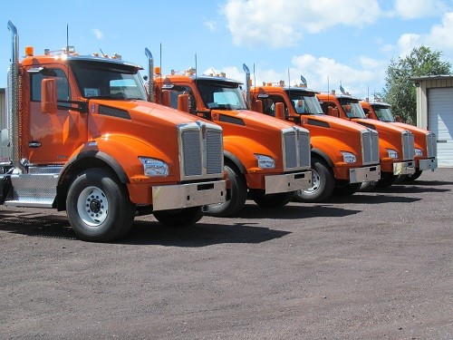
Accomplishments: Equipment to Support Routine Road Maintenance
Replaced aged out equipment to support Routine Road Maintenance per current standard of 10 years or 10,000 hours
Given six years of virtually no equipment replacement, backlog of replacements exceeds budget
Consultant reviewed replacement standard
Notes:
We made an investment of $2.5 million to secure equipment including: 1 Motor grader, 6 Semi Tractors, 4 Dump Trailers, 2 Low Boy Trailers, 1 Cinder/Plow Truck, 6 Cinder Spreaders, 1 Water Truck, 11 Pickup Trucks and 2 Roadside Message Boards

Slide 20
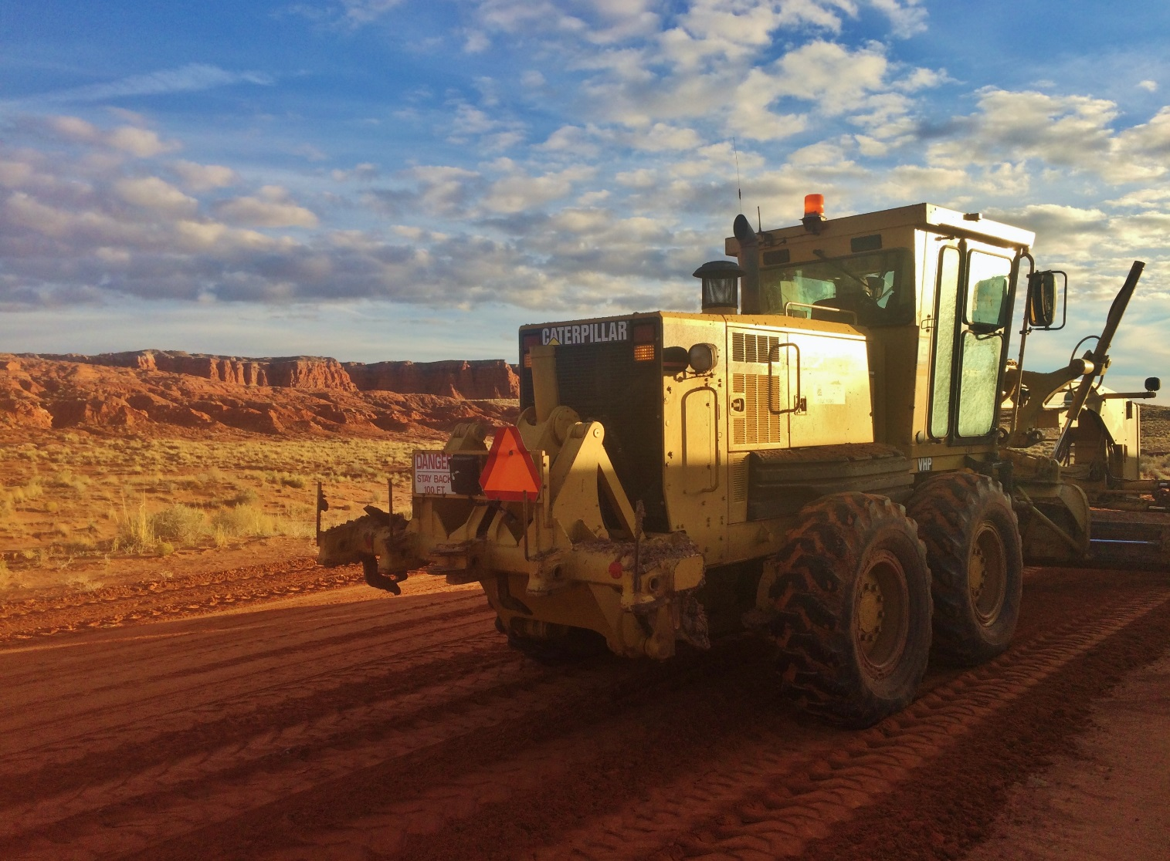

Accomplishments: Navajo Nation Road Maintenance
Increased miles maintained by the County by 30% - added additional Senior Operators to meet the service level agreed to by Prop 403
Worked with the NNDOT and BIA on establishing a plan for implementing the Capital Matching Fund Program
Developed Navajo Nation Road Maintenance Video to communicate County’s commitment to maintaining roads on the Nation
Notes:
(Read Slide)

Slide 21
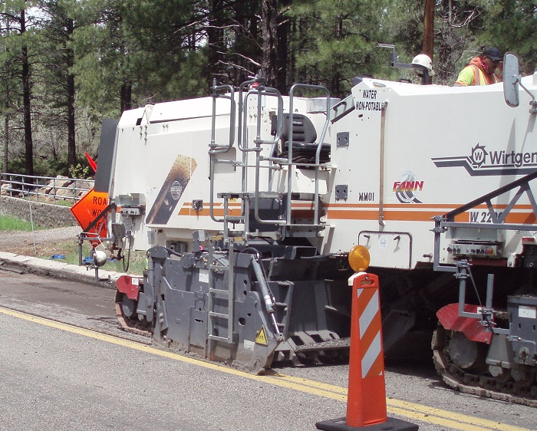
Accomplishments: 10 Year Capital Improvement Plan
First 5 Years – Invest +/- $5 million per year; future years invest +- $3 million per year
Several larger projects are partially funded & managed by ADOT or FHWA
Several factors can influence planning, timing & level of investment
Completed all projects planned for FY 2015- 2017, and on track to deliver FY 2018 Projects
Notes:
The County’s actual annual investment in the Roads CIP will be affected by:
Economic downturns, which impact the total revenue generated from the sales tax and the gasoline tax
Annual maintenance costs, such as snow severity, and cost of oil, gasoline & diesel
Road/bridge failures
Response to disasters

Slide 22
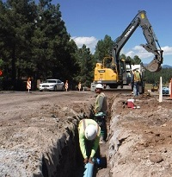
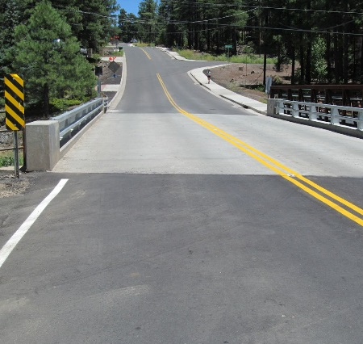
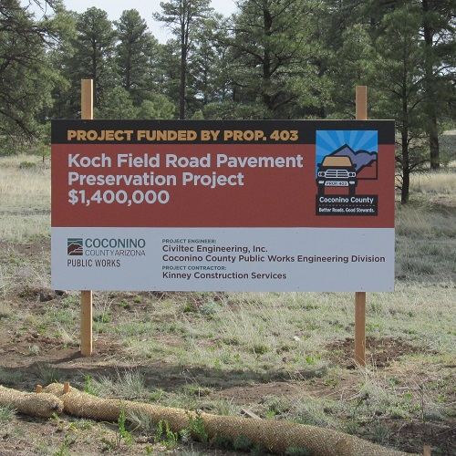
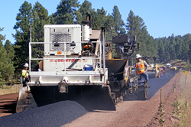
Accomplishments: Capital Projects
Exceeded Expectations
FY 2016 - $8.5 Million
FY 2017 - $8.7 Million
Notes:
We have exceeded our expectations. We originally projected revenues to be $5-$7 million and in FY16 they were $8.5 million and in FY17 they were $8.7 million.
The Pinewood Boulevard Reconstruction Project included a new base and asphalt overlay for the roadway for just over one mile of Pinewood Boulevard from I-17 to the Munds Wash Bridge. concrete curbs were replaced in the commercial area.
The Munds Wash Bridge Repair Project included replacement of the bridge deck and existing railing and the addition of a guardrail on the approach side of the bridge.
In addition to pavement improvements to Koch Field Road between Silver Saddle Road and Townsend-Winona Road, the Koch Field Road Pavement Preservation Project features widened shoulders for multimodal use and improve localized drainage along the roadway.
Two Townsend-Winona Road Rd projects completed: $2.1 million project ($600,000 of which is from a federal grant) to mill and overlay Townsend-Winona Road for the 2.2 miles between I-40 and Leupp Road. The second $3.8 million project to mill and overlay more than four miles of Townsend-Winona Road from Leupp Road to Rio Rancho Road.
Others:
Cosnino Rd Project- $2.4 million, Kachina Trail Reconstruction Project, Lake Mary Rd

Slide 23
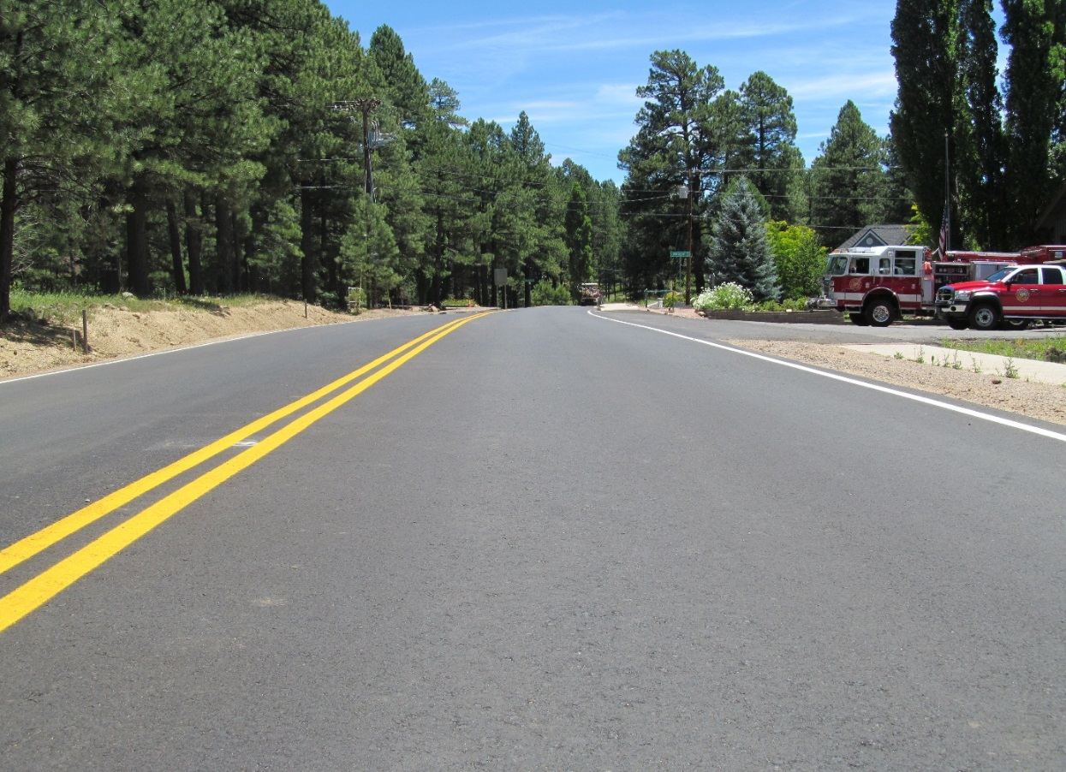
What Will The Future Hold?
County initiative sunsets Dec 31, 2034
Average cost of maintenance, products and materials will escalate
HURF funds most of local government road maintenance
State initiative needed and needs to include an escalator
We will need to re-evaluate as we get closer to our sunset date
Notes:
(Read Slide)

Slide 24
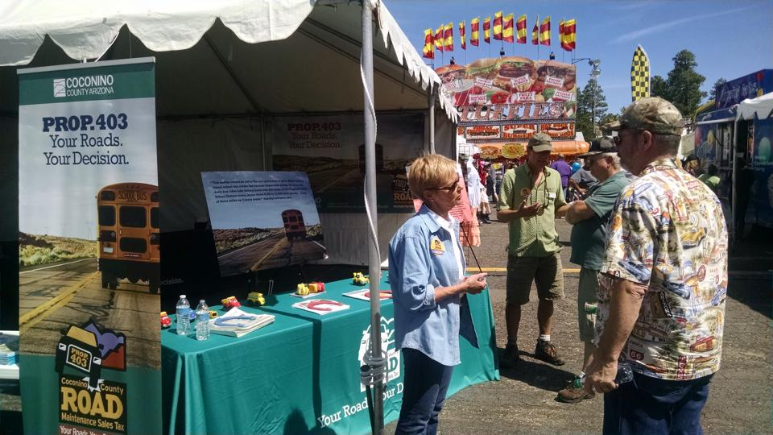
Lessons Learned (Advice to Others): Four Crucial Elements
1. A demonstrated need that was
scientifically assessed and determined
2. Guarantee that money would be used
only for County road maintenance and
improvements - local control over locally
generated funds
3. Effectively communicate impact of reduced
service & long-term impact
Then…
A comprehensive and intense Public information program - Listening and communicating effectively with voters – do not take anything for granted!
Notes:
Four elements proved to be crucial:
A demonstrated Need that was scientifically assessed and determined
Guarantee that money would be used only for county road maintenance and improvements - Local control over locally generated funds
Effectively communicate impact of reduced service & long-term impact
THEN …. A comprehensive and intense Public information program - Listening and communicating effectively with voters – do not take anything for granted!
Total team effort with major investment of time by the Board, County Manager & Public Works Staff

Slide 25




Questions
For More Information
Go to coconino.az.gov/CountyRoads
Like “Coconino County Roads”
Follow @CoconinoRoads
Email countyroadsinfo@coconino.az.gov
Call (928) 679-8300

