Slide 1
AASHTO SCOP Linking Planning to Programming P2P Link
ADOT P2P Link
ADOT Vision and Long-Range Plan Planning to Programming (P2P) Linkage Prototyping P2P Link
Implementation
Rural Transportation Summit
January 16, 2014

Slide 2
Notes:
Changing World
Timeliness

Slide 3
P2P Link Goal
To create a performance-based process that links planning to programming
transparent, defensible, logical, reproducible
Notes:
Establish a performance-based management mindset and approach
Address asset management needs for managing infrastructure
Allocate resources efficiently through a risk-based process
Increase annual programming efficiency by establishing 10-Yr Program - Development (years 6-10) and Delivery (years 1-5)
Comply with MAP-21 requirements
Continually adapt to changing requirements and needs
Consider a range of funding sources and opportunities

Slide 4
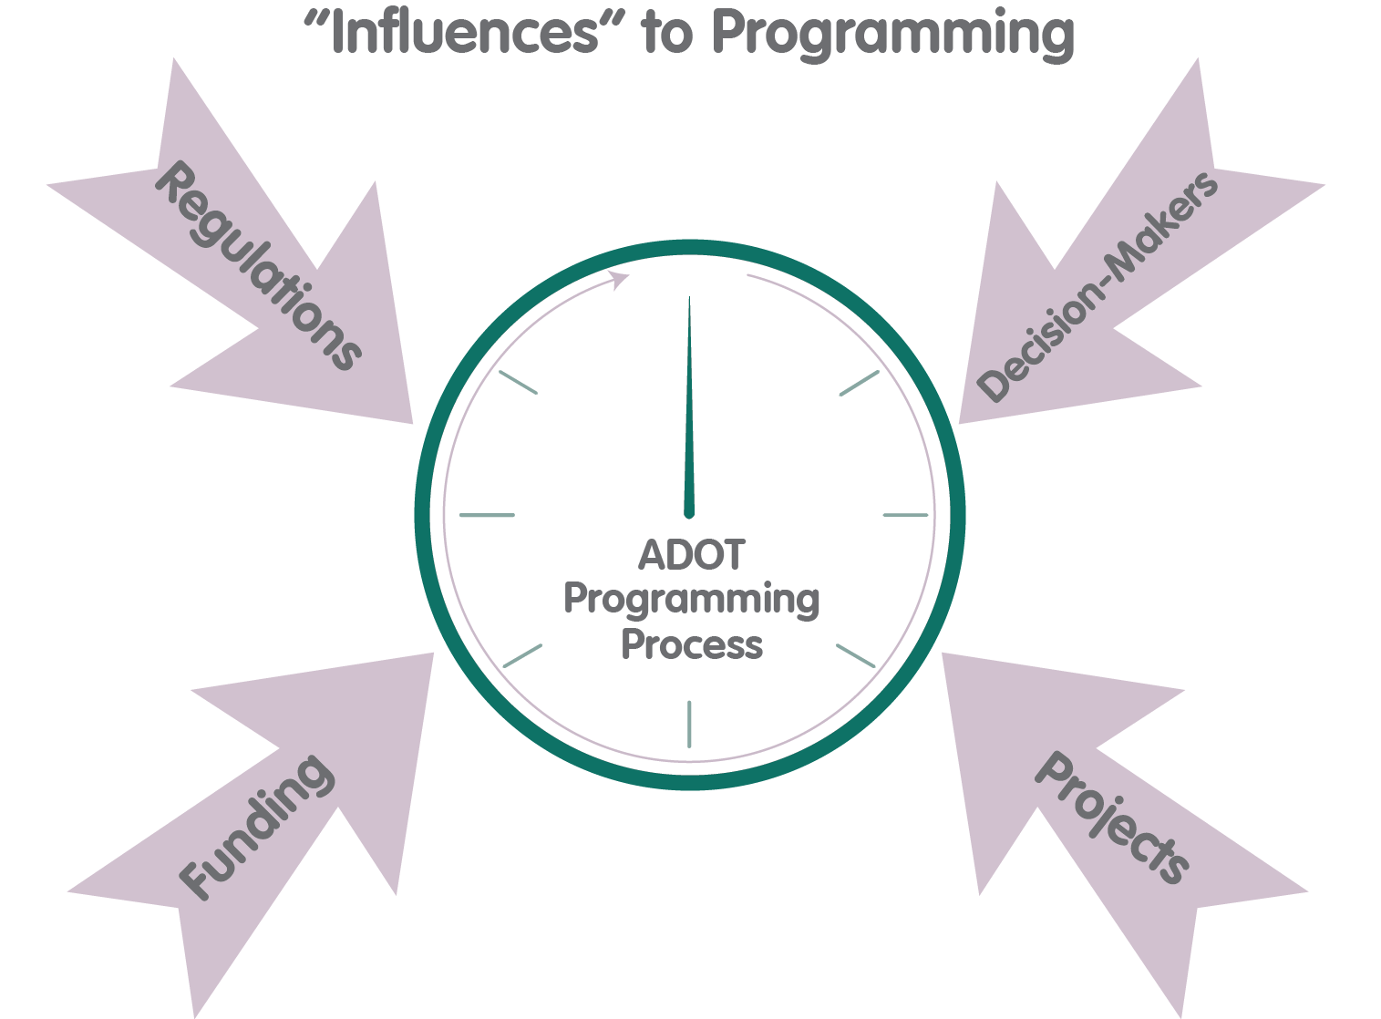
Developing P2P Link
Recognize Concurrent Program Updates and State Transportation Board Programming Outcomes
Identify P2P Link Business Requirements
Review of Current Practice and Best Practice
Develop Concept Models
Define P2P Process and Methodologies
Migrate to New Process

Slide 5
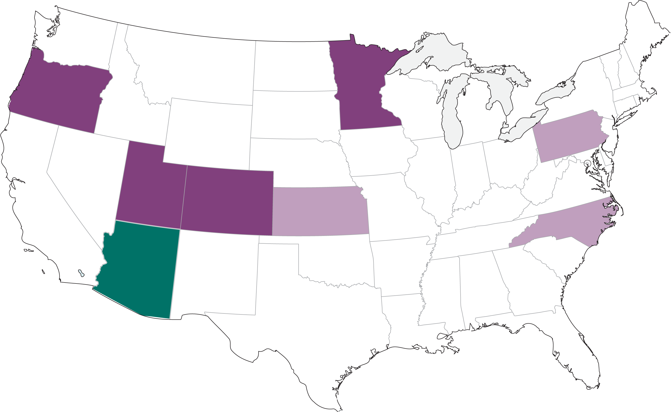
Process Collaboration
ADOT Leadership – All Divisions
ADOT Management and Technical Staff
Arizona MPOs/COGs
FHWA
Peer States
Notes:
Focus on importance of peer interaction—relevant to AASHTO audience
Involving peer states
Self assessment
Learn from others
Choosing ADOT’s peers
Program size
Economic base; Phoenix & Tucson population centers
Statutory / legislative structure
Peer state participation
All day workshop; presentations, panels, work sessions
Process critiques thru web meetings
Support as needed

Slide 6
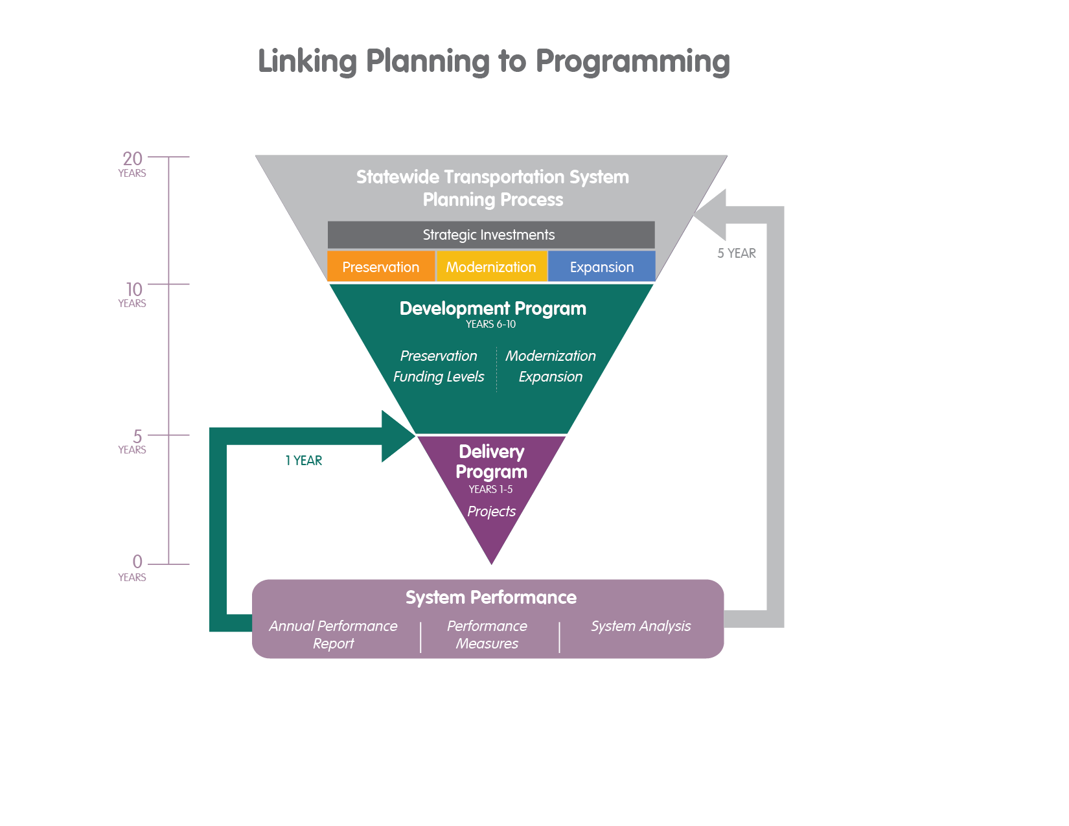
Linking Planning to Programming
Notes:
System Performance is the foundation

Slide 7
System Health (Sustainability)
Infrastructure
Pavement
Bridge
Other Roadway
Facilities
System Performance
Reliability
Congestion Reduction
Asset Condition
Safety
Air Quality
Resources
People
Funds
Equipment
Supporting Facilities
Notes:
Balance
Foundation

Slide 8
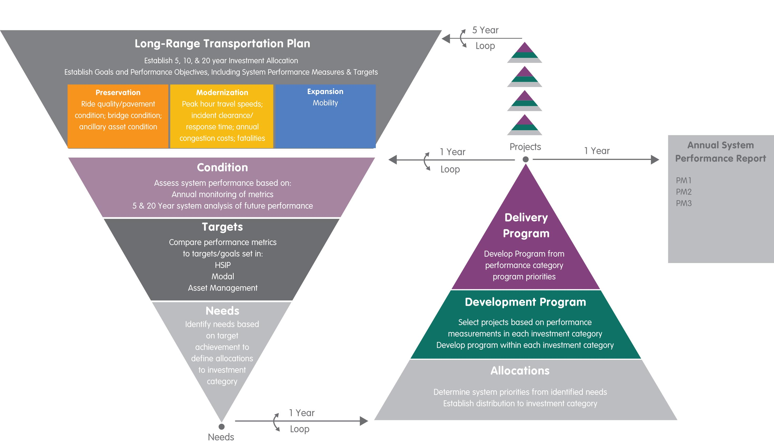
System Performance Monitoring
Notes:
Updated by Caprice 10/9

Slide 9
Program Investment Categories
Notes:
Updated by Caprice 10/9

Slide 10
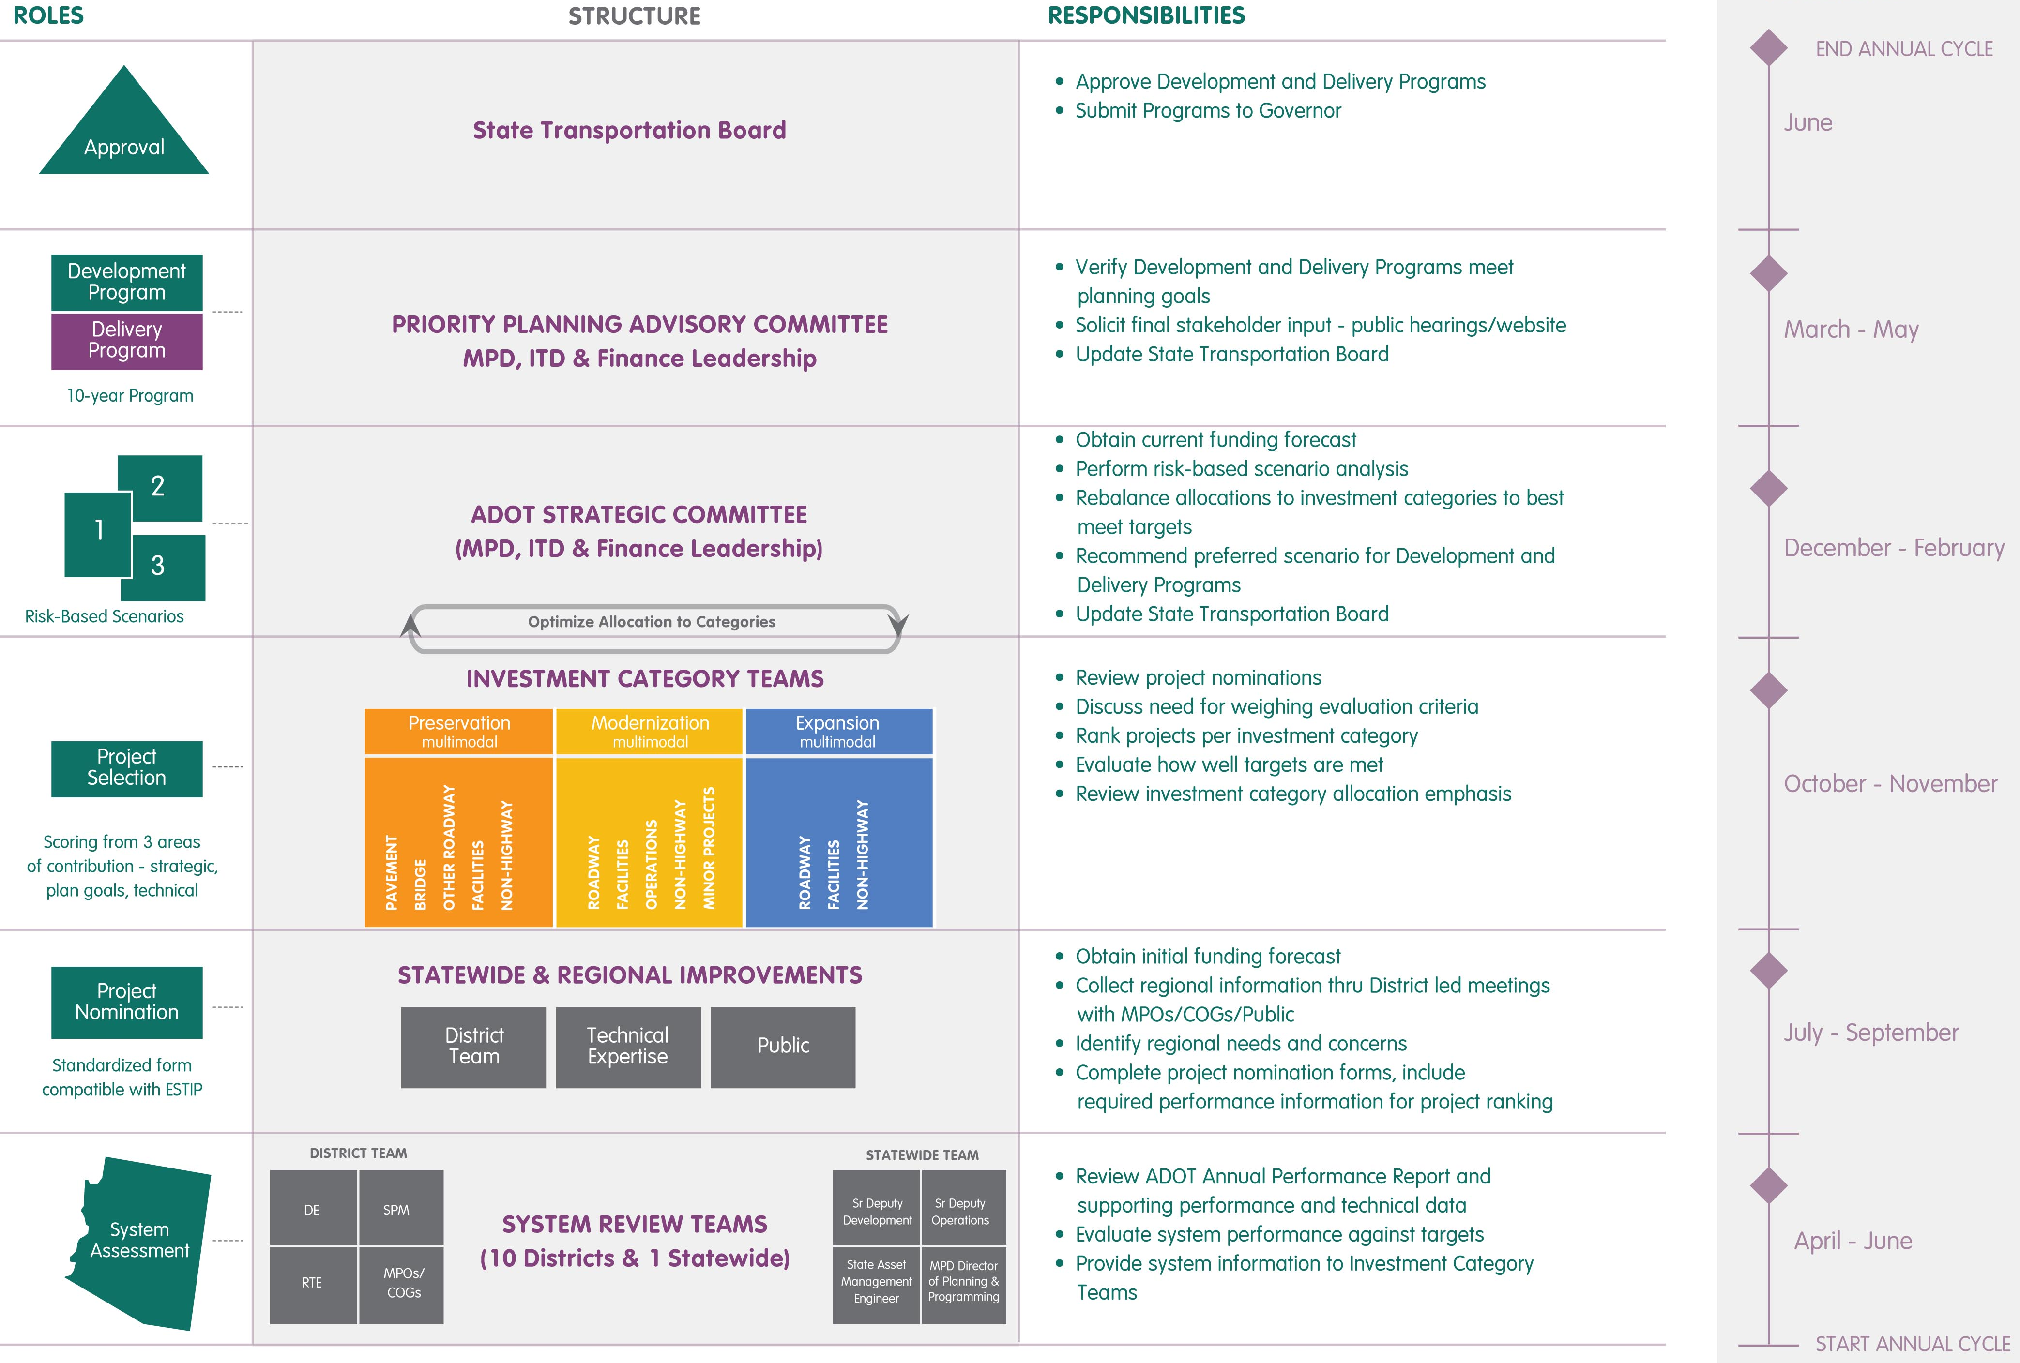
Annual Program Update
Notes:
We recognize that it is not just a system of hard assets and data—it is about people—the people who plan, evaluate, and program the system, and the people who pay for it and use it
Focus on top and right-hand axes, not detail
Talk about building consensus and ownership from the ground up (similar to ground-up story of system performance being the foundation in previous slides

Slide 11
P2P Link Reality Check
Ensure approach is technically sound and not onerous to undertake
Operationalize the evaluation criteria
Involve management and technical staff in developing and using the process
Calibrate against the existing construction program

Slide 12
Evaluation Criteria
Relate planned system performance to project ranking
Consistent with MAP-21 performance measurements
Consider the best set of performance indicators to prioritize projects within each investment category
Utilize the fewest criteria to yield meaningful results in ranking projects
Minimize overlapping criteria that result in unintentional weighting
Project Ranking
Criteria
Score
Project
Notes:
The evaluation criteria provide the connection between project and system performance. They are consistent with the performance measurements anticipated by MAP-21, thereby connecting project ranking with system performance. As performance goals and objectives change over time, the evaluation criteria may also need to be adjusted so that they implement the planned for system performance.
Each category included several considerations in determining what the best set of performance indicators would be to prioritize projects within. The intent was to decide upon the fewest number of criteria as possible that would yield meaningful results in ranking projects. The approach focused on minimizing overlapping criteria, which would measure similar outcomes and result in unintentional weighting.

Slide 13
Preservation - Bridge
Policy Goals | Manage assets to reduce life cycle costs, set and manage preservation targets and ensure safe, reliable operation of the transportation system
How Projects Accomplish Goals | Improve reliability of the system by mitigating unexpected closures or failures Maximize the service life of the facility by following technically defined preventive maintenance treatments Manage the asset by pursuing lowest lifecycle cost strategies
Eligible Work Types | Inspection-Triggered Bridge Repair Preservation/Minor Rehabilitation Deck overlay (minor or major) Substructure retrofitting Major Rehabilitation/Reconstruction Reconstructing bridges that are structurally deficient Rehab/replacement (NOT due to functional obsolescence)

Slide 14
Preservation - Pavement
Policy Goals | Manage assets to reduce life cycle costs, set and manage preservation targets and ensure safe, reliable operation of the transportation system
How Projects Accomplish Goals | Improve reliability of the system by mitigating unexpected closures or failures Maximize the service life of the facility by following technically defined preventive maintenance treatments Provide consistent ride quality to users
Eligible Work Types | Preservation Treatments Surface Seal Thin Overlay Rehabilitation Minor –Mill & Fill Major – Structural Overlays or Resurfacing Reconstruction Major rehabilitation work at the end of pavement service life (NOT due to functional obsolescence or updating geometric design standards)

Slide 15
Modernization
Policy Goals | Improve safety and reliability, reduce congestion, improve economic vitality, increase multimodal usage
How Projects Accomplish Goals | Improve productivity of the existing system Reduce safety risk Reduce travel time
Illustrative Eligible Work Types | Widening existing lanes/shoulders Intersection and interchange reconfiguration Enhancements to address functional obsolescence Traffic control and management Safety modifications/enhancements ITS modifications/enhancements Bicycle lane improvement

Slide 16
Expansion
Policy Goals | Provision of transportation system capacity to provide mobility and support economic productivity
How Projects Accomplish Goals | Provide capacity to meet current and future travel demand at acceptable levels of service
Illustrative Eligible Work Types | New routes New lanes New Interchanges/Intersections Interchange/Intersection Capacity Enhancement

Slide 17
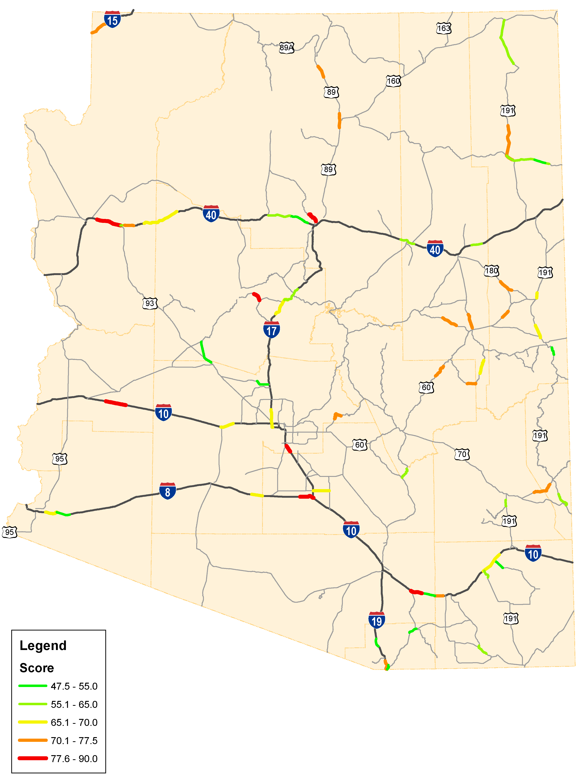
Observations from Prototyping
No fatal flaws identified so far…
ADOT has good alignment among leadership, line managers, and technical managers allowing for good process flow
Prioritized projects can be geographically mapped
Data for preservation evaluation criteria are available and easy to use
Modernization evaluation criteria have been identified, but will require further analysis to validate
Expansion evaluation criteria have been identified, but may be time-consuming to develop

Slide 18
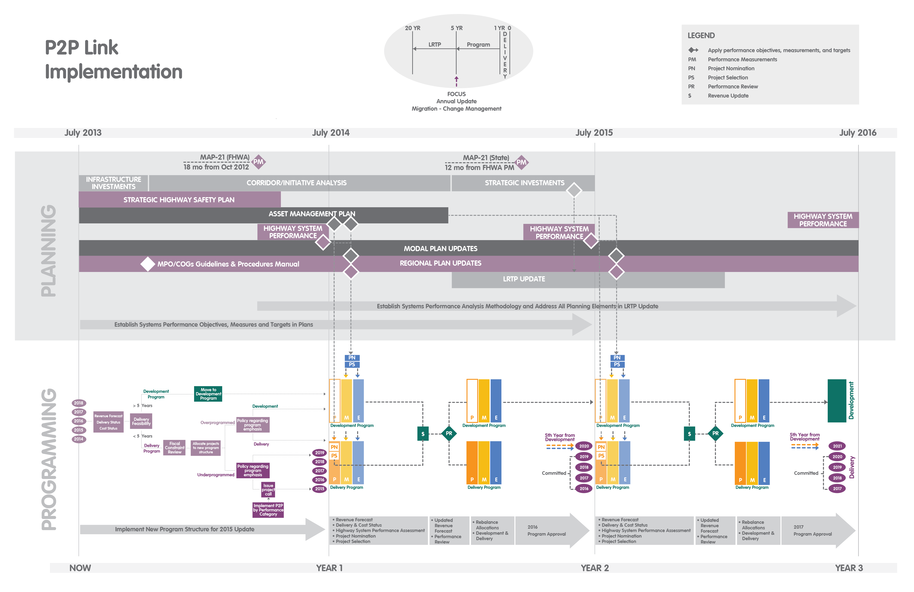
Implementation Considerations
3-year Implementation Strategy Plan
MAP-21 Performance Measurements
New Planning Required: Strategic Highway Safety Plan, Asset Management Plan, System Performance Analysis
Planning Updates Required: LRTP, Modal Plans, Regional Plans, etc.

Slide 19
3-Year Strategy Plan
Year 1 – Initiate Planning Efforts and the 10-Year Program Plan
Define scope and timeline for Asset Management Plan, System Performance Analysis and LRTP Update
Implement new 10-Year Program structure
Define methodology of System Performance Analysis
Year 2 – Implement System Performance Program
Evaluate the current program balance among the investment categories pending plan updates
Prepare the first System Performance Analysis Report
Year 3 – Update the LRTP
Refine overall methodology for System Performance Analysis and address the identified needs in the LRTP update
Identify Strategic Investments in the LRTP update

Slide 20
Anticipated Benefits
Transparent, defensible, logical, reproducible process for programming improvements
Truly linking planning to programming to use funds more effectively
System performance will drive investment decision making
Simplified program structure
Implementation of a risk-based approach
Assist with implementation of MAP-21
P2P Link will change business practices at ADOT

Slide 21
AASHTO SCOP Linking Planning to Programming P2P Link
ADOT P2P Link
Questions?
Thank you!

