Slide 1
Creatively funding public transit
Ron romley and ed steinback,
yavapai regional trasnit
Mike Normand, ADOT

Slide 2
Chino Valley Transit >>>>> Yavapai Regional Transit Inc.

Slide 3
Volunteer Drivers

Slide 4
Promotion and Community outreach

Slide 5
Slogans and find identity

Slide 6
Volunteer riders and helpers

Slide 7
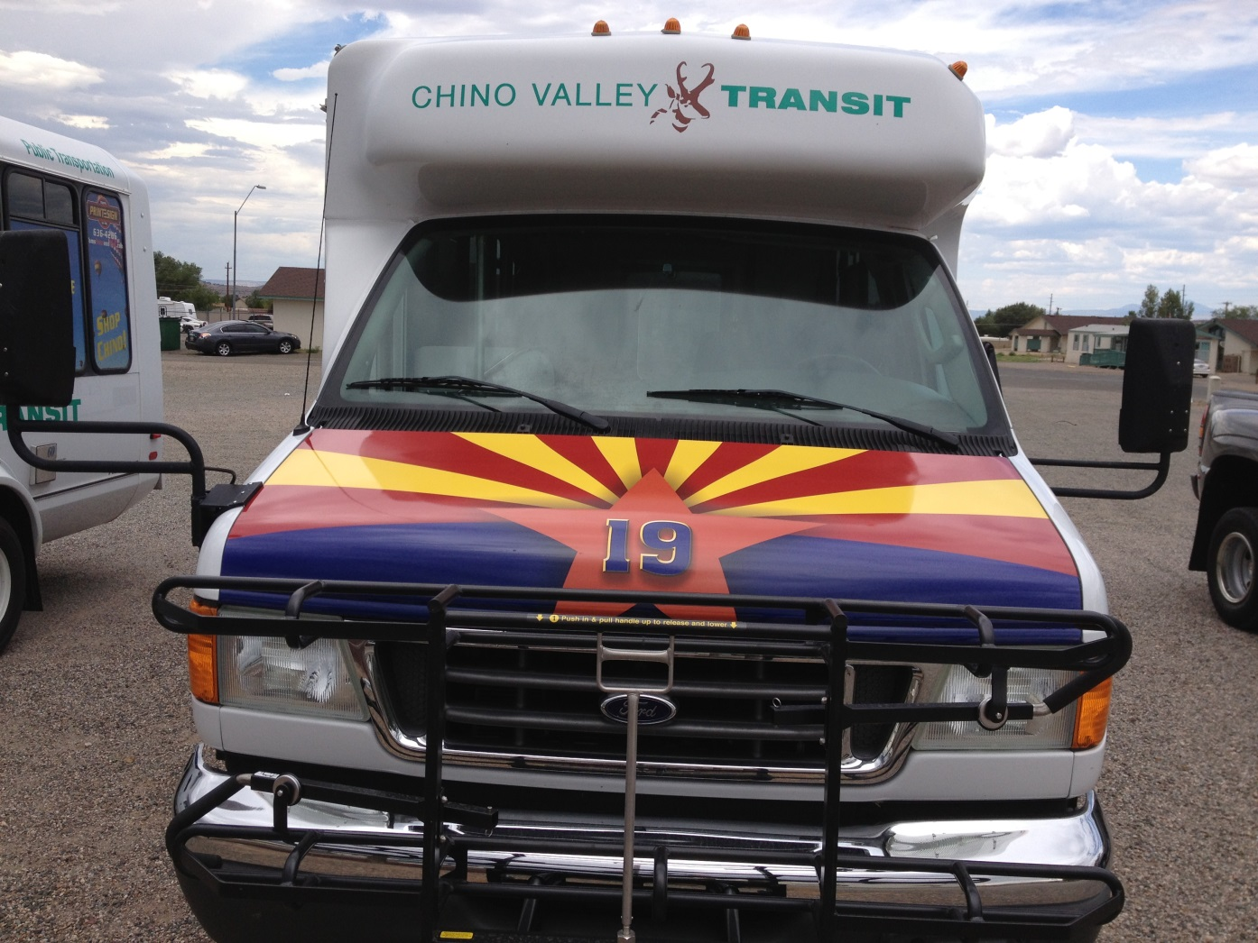
Create unique identity

Slide 8
Advertising revenues

Slide 9
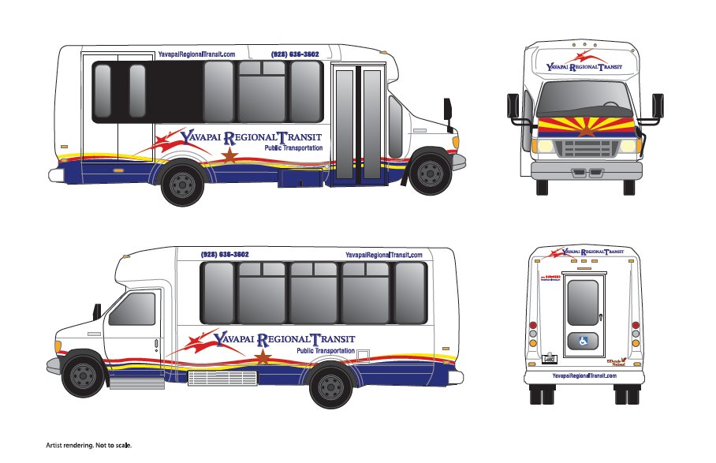
Rebranding

Slide 10
Yavapai regional transit
Corporate structures and design

Slide 11
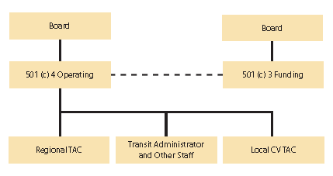
Corporate Structures

Slide 12
Yavapai regional transit 501(c)4
Operations
Planning
future
present
ongoing
Public relations
Grants
community based
government
Advertising
Support revenues
Endowment

Slide 13
Yavapai regional transit 501(c)3
Planning
future and ongoing
Public relations
Community Involvement
Donations
Training/ CPR Classes
Friends of Transit
Grants
community based
government
Sponsorships deductible net of benefits
Children’s Education
Endowment

Slide 14
Economics benefits of a transit system
1. For a rural transit system, for every $1 invested, there are $4 in economic returns
2. For every $1 million in operating investment yields $3.2 million in increased business sales locally.
3. Individuals save 785 million hours in travel time and 640 million gallons of fuel annually
4. Avoids the emission of more than 126 million pounds of hydrocarbons and the emission of 156 million pounds of nitrogen oxides

